Slide 1

My wealth of nations project
Carlton Okot
23/02/2024

Slide 2
Parts
1. Research about wealth of nations
2. Excel spreadsheets
3. Tableau

Slide 3
Table of Contents
Page 4 :
Research done based around the wealth of nations
Why the countries are why the are
Who causes the changes
Page 5 :
Building charts
Singling out a Year
Putting Background
Page 6-8 :
Importing data
- Building relationships and charts

Slide 4
Research
Maintaining Trust and Reputation: Following data protection policies demonstrates a commitment to respecting individuals' privacy rights and maintaining the confidentiality of their information. This helps build trust with customers, clients, and stakeholders, safeguarding the organisation's reputation.
Preventing Data Loss or Corruption: Computer misuse policies establish guidelines for the appropriate use of technology resources, including computers, networks, and software. Adhering to these policies helps prevent unauthorised access, data loss, or corruption due to malicious activities such as hacking, malware, or insider threats.
Ensuring Business Continuity: By adhering to data protection and computer misuse policies, organisations can minimise the risk of disruptions caused by security incidents or regulatory violations. This helps ensure business continuity and protects against potential financial losses or operational disruptions.
Overall, adherence to data protection and computer misuse policies is crucial for protecting personal data, complying with legal requirements, maintaining trust and reputation, preventing data loss or corruption, ensuring business continuity, and promoting ethical behaviour within organizations.

Slide 5
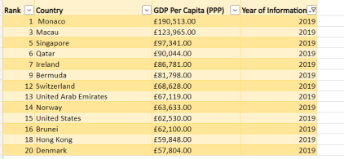
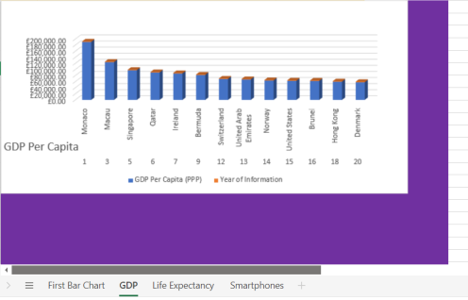
Excel Spreadsheets
- Changed currency from $ to £ by clicking the arrow under ‘Number’, selecting Category ‘Currency’
Singled out the first 20 ranked countries in the year 2019 by clicking a column and ‘Ctrl +F’ , Find and replace 2019.
Formed into a table and by selecting all rows and columns behind this table I coloured it Purple
Placed directly under the Top 20 chart.

Slide 6
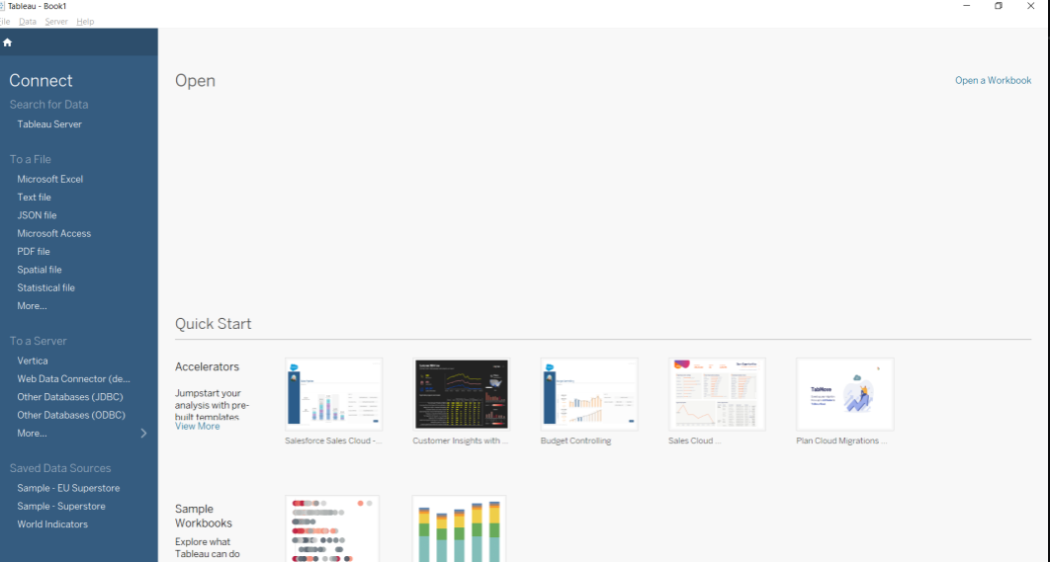
Tableau
Imported my data here by clicking ‘Microsoft Excel’ on the left, and then selecting my Wealth of Nations data file.
Then set relationships between Country (GDP), Country (Life Expectancy) and Country (Smartphones), and moved onto tables.

Slide 7
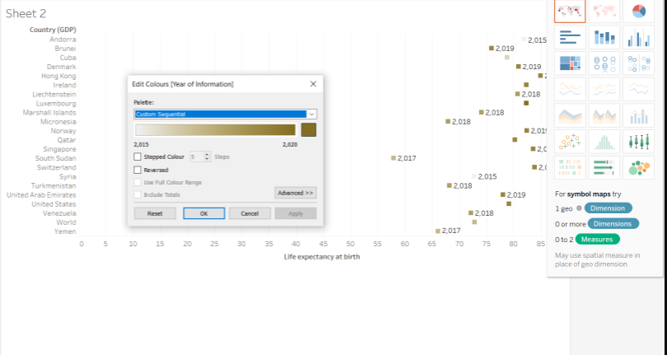
Tableau
As I created my tables, I used various designs such as scatter plots to make sure it was visually satisfying.
I made the colour around orange to support the persons problem with being colour blind

Slide 8
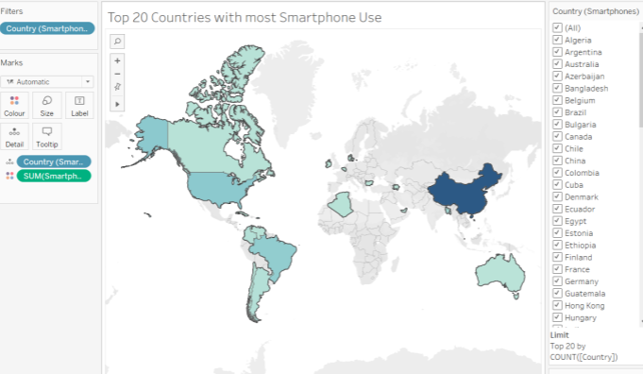
Tableau
As you can see here I have created an amazing world map.
The blue helps the colour blind
The bottom right show that I filtered to only count the top 20 ranked countries
I have filtered the SUM of the smartphones
As you hover over any of these blue highlighted countries, it will magnify the statistics.
The more blue a country is, the more users of smartphones it has.

